Slide 1
The ODOT – Columbus State Construction Inspection Workforce Program (CIWP)
Formal Education, Certification & Internship

Slide 2

What is the Construction Inspection Workforce Program (CIWP)?
A joint effort of Columbus State, ODOT & ACEC Ohio to create a workforce of job-ready entry level consultant construction inspectors – the next generation of highway & bridge construction inspectors

Slide 3
ODOT - Columbus State CIWP
Education
  36 Credit Hours of Applied Civil Engineering, Construction Management and Surveying Courses
Certification
  National Institute for Certification in Engineering Technologies (NICET) Levels I&II Highway Inspection & ODOT Required Certifications of ACI Level I, Ohio Asphalt, Ohio Aggregate and Work Zone Safety
Internship
  Formal 12-month paid internship working for an ODOT qualified engineering consultant on ODOT-related projects

Slide 4
Why Now? Why the CIWP?
Shortage of Qualified & Experienced Inspectors –
retiring Baby-Boomers, no real pipeline for new inspectors
Increased Complexity of inspection due to technology requires more formal education, industry standard certifications & formal internships
Formal industry supported programs that include formal education, certification & internships lead to
  Better careers, higher paying jobs, continuing opportunities – higher performing, more productive employees
  Better use of taxpayers $$’s
Large and numerous highway & bridge projects in Ohio (and surrounding states) due to aging 1960’s infrastructure - all coming due for replacement

Slide 5
Goals & Deliverables
Started May 17, 2018 – Goal of 1st CIWP “Graduates” Prequalified as ODOT Consultant Construction Inspectors – Late 2020
Curriculum Supportive of Becoming Certified w/NICET Levels I&II
Education Credit Towards NICET Levels I&II Experience Requirements
CSCC as “One Stop Shop” for Students (and Employers)
  Formal Education
  NICET Certification Testing
  Curriculum & Certifications for ACI Level I, Ohio Aggregate Level I
  Curriculum & Testing for Flexible Pavement and Work Zone Safety Tests
  Internship Opportunities
Outreach Plan to Existing Students and Career Technical High Schools
Agreement w/ODOT and ACEC Ohio for Internships
Program Tri-Fold Brochure & Weblink
Benchmarking w/State DOT’s, Community Colleges & Industry Advisory Group
Program Operations Manual/Guidebook

Slide 6
ODOT - Columbus State CIWP
Career Pathway Next Steps
Educational Path Starting with CIWP
Associates of Applied Science in Civil Engineering Technology (AAS CET)
Associate of Applied Science in Surveying
Associate in Applied Science in Construction Management
AAS CET > Bachelor of Science in Civil Engineering
(Ohio University)

Slide 7
ODOT - Columbus State CIWP
Career Pathway Next Steps
Certification & Licensure Paths Starting with CIWP
ODOT Prequalified Inspectors + Additional Certifications
- Project Structure Inspector
- Coatings Inspector
- Traffic Signal and Lighting Inspector
Soils and Aggregate Inspector
NICET Levels III & IV
BS in Civil Engineering (Ohio University)
+ Experience and Testing = Licensed Professional Engineer (PE)
Construction Engineer/PM – Contractor & Inspectors Work for You…

Slide 8
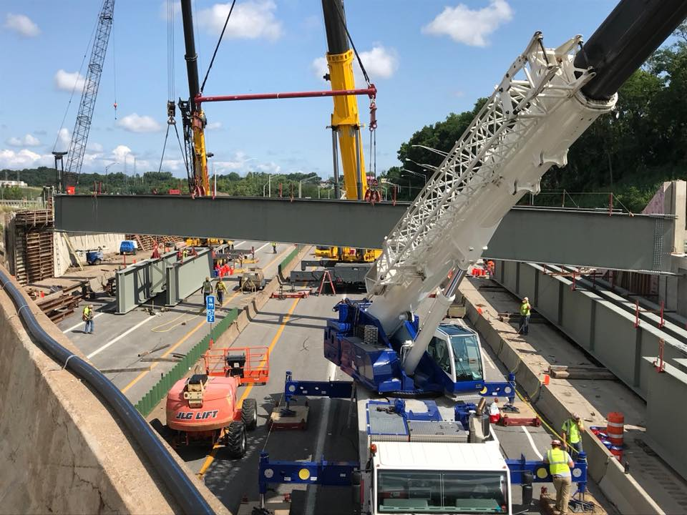
Find Out More
Questions/Answers?
www.cscc.edu/CIWP
Columbus State Contacts:
Jon Link • jlink@cscc.edu • 614-287-5034
Doug House • dhouse1@cscc.edu • 614-287-2576
Email questions to construct@cscc.edu or call 614-287-5949
ODOT Contact:
Merka Flynn • Merka.Flynn@dot.ohio.gov •
614-752-9018

